Slide 1
Communication
MODULE 2
Prof Ashok Patade

Slide 2
Content
2.1 Layered Protocols, Interprocess communication (IPC): MPI, Remote Procedure Call (RPC), Remote Object Invocation, Remote Method Invocation (RMI).
2.2 Message Oriented Communication, Stream Oriented Communication, Group Communication.

Slide 3
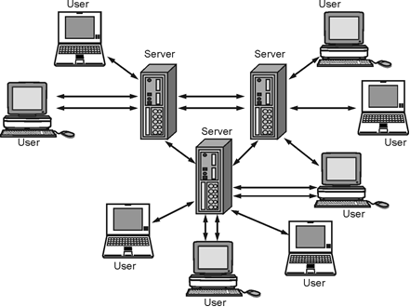
Define Inter-process Communication. Explain different types of Communications.
Fig. 2.1.1: Inter-process Communication in Distributed System

Slide 4
Inter-process communication has two functions: Synchronization and Message Passing.
Inter-process communication requires synchronization. It refers to a situation in which the data used to communicate between processors is control information. It is either provided by the inter-process control mechanism or handled by the communicating processes.
In message-passing systems, processors communicate with one another by sending and receiving messages over a communication channel.Message passing takes several forms such as pipes, FIFO, Shared Memory, and Message Queues.

Slide 5
Types of Communications
(1) Persistence
(2) Transient
(3) Asynchronous
(4) Synchronous
(5) Persistent synchronous communication
(6) Transient asynchronous communication
(7) Receipt-based transient synchronous communication
(8) Delivery-based transient synchronous communication
(9) Response-based transient synchronous communication

Slide 6
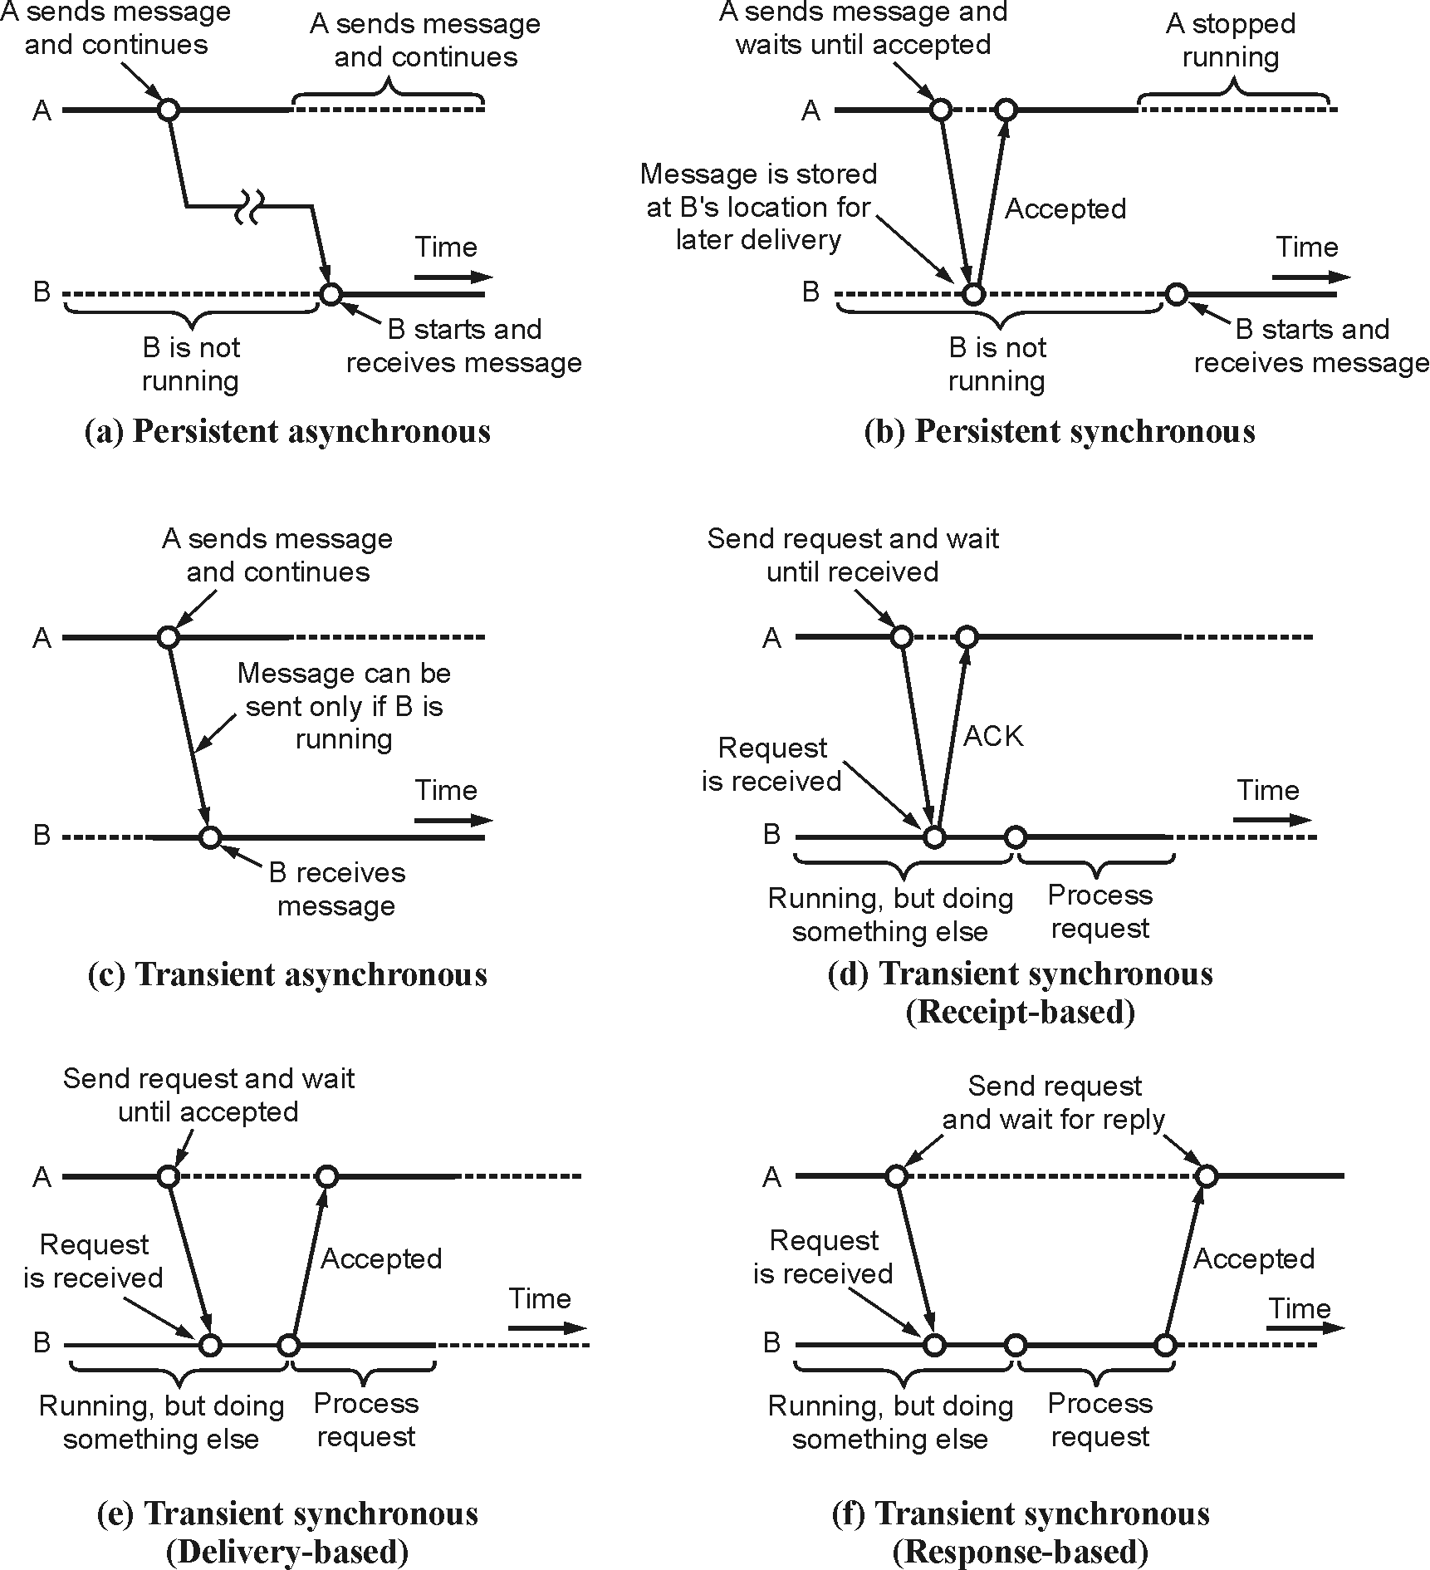
Fig. 2.1.2 : Types of Communications

Slide 7
Message Passing Interface (MPI)
MPI also has more advanced primitives of different forms of buffering and synchronization.
MPI_bsend
MPI_send
MPI_ssend
MPI_sendrecv
MPI_isend
MPI_issend
MPI_recv
MPI_irecv

Slide 8
MPI Communication Methods
(1) Point-to-Point Communication
(2) Collective Communication
(3) One-Sided Communication

Slide 9
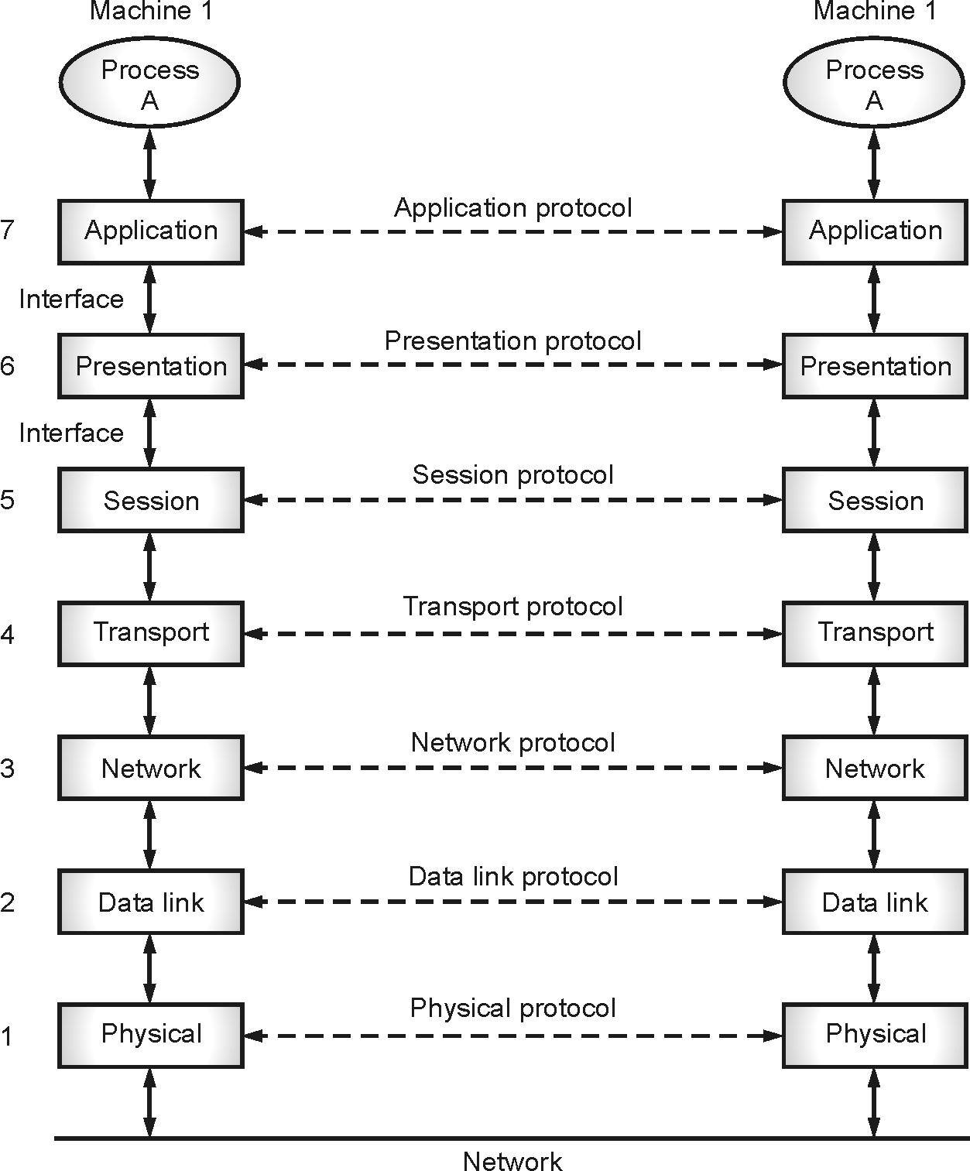
Layered Protocols
Fig. 2.2.1 : ISO-OSI Reference Model

Slide 10
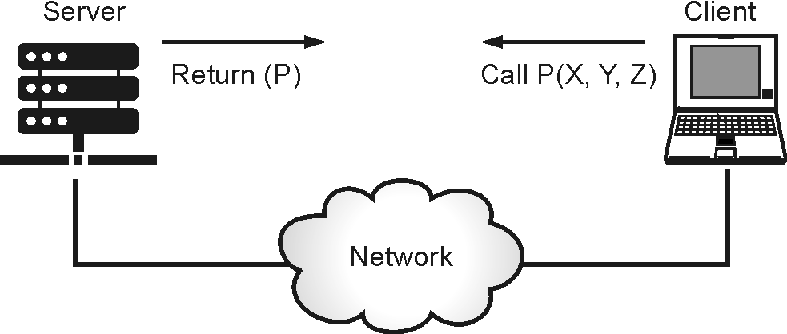
Remote Procedure Call (RPC)
Fig. 2.3.1 : Model of Remote Procedure Call

Slide 11
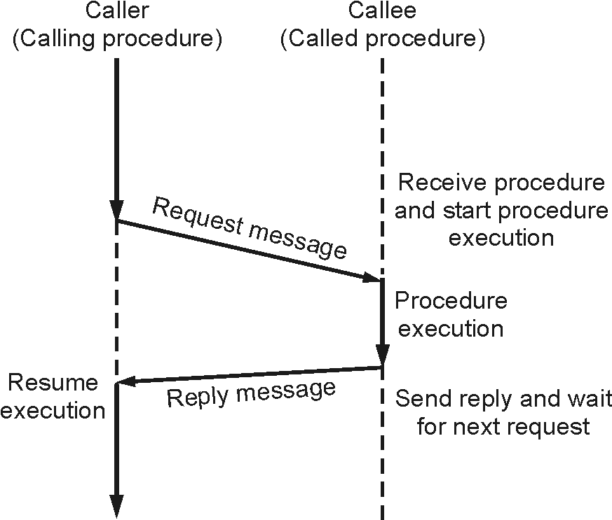
Fig. 2.3.2 : Implementation of RPC

Slide 12
The two major components of the RPC model are :
(1) Calling Procedure :
(2) Called Procedure (remote Procedure) :

Slide 13
The two types of messages involved in the implementation of an RPC system are as follows :
(1) Call Messages : They are sent by the client to the server for request execution of a particular remote procedure.
(2) Reply Messages : They are sent by the server to the client for returning the result of remote procedure execution.

Slide 14
Features of RPC
In an operating system, remote procedure call (RPC) has the following features, such as :
(1) RPC hides the complexity of the message passing process from the user.
(2) RPC only uses specific layers of the OSI model like the transport layer.
(3) Clients can communicate with the server by using higher-level languages.
(4) RPC works well with both local environments and remote environments.
(5) The program of RPC is written in simple code and is easily understood by the programmer.
(6) The operating system can handle processes and threads involved in RPC easily.
(7) The operating system hides the abstractions of RPC from the user.

Slide 15
Types of RPC
(1) Synchronous RPC :
(2) Nonblocking RPC :
(3) Batch-mode RPC :
(4) Functions of Batch-mode RPC :
(5) Broadcast RPC :

Slide 16
Extended RPC Models
(1) Lightweight RPC (Doors)
(2) Asynchronous RPC
(3) Deferred Synchronous RPC
(4) One-way RPC

Slide 17
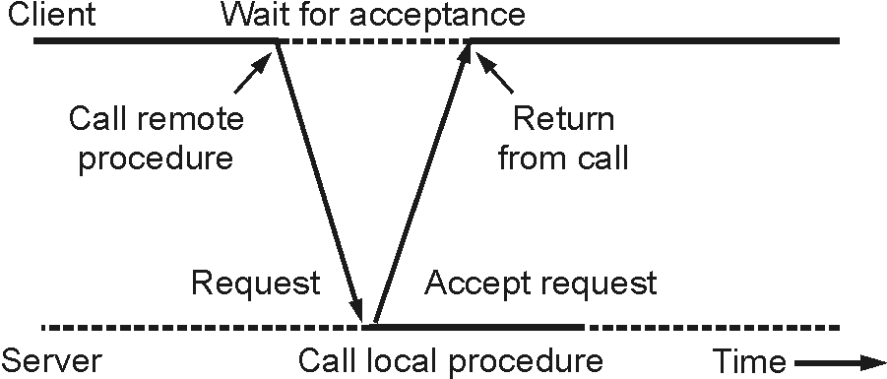
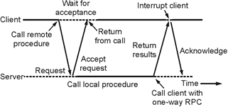
Fig. 2.3.3 : Asynchronous RPC
Fig. 2.3.4 : Deferred Asynchronous RPC

Slide 18
Implementing RPC Mechanism
The Client
The Client Stub
The RPC Runtime
The Server Stub

Slide 19
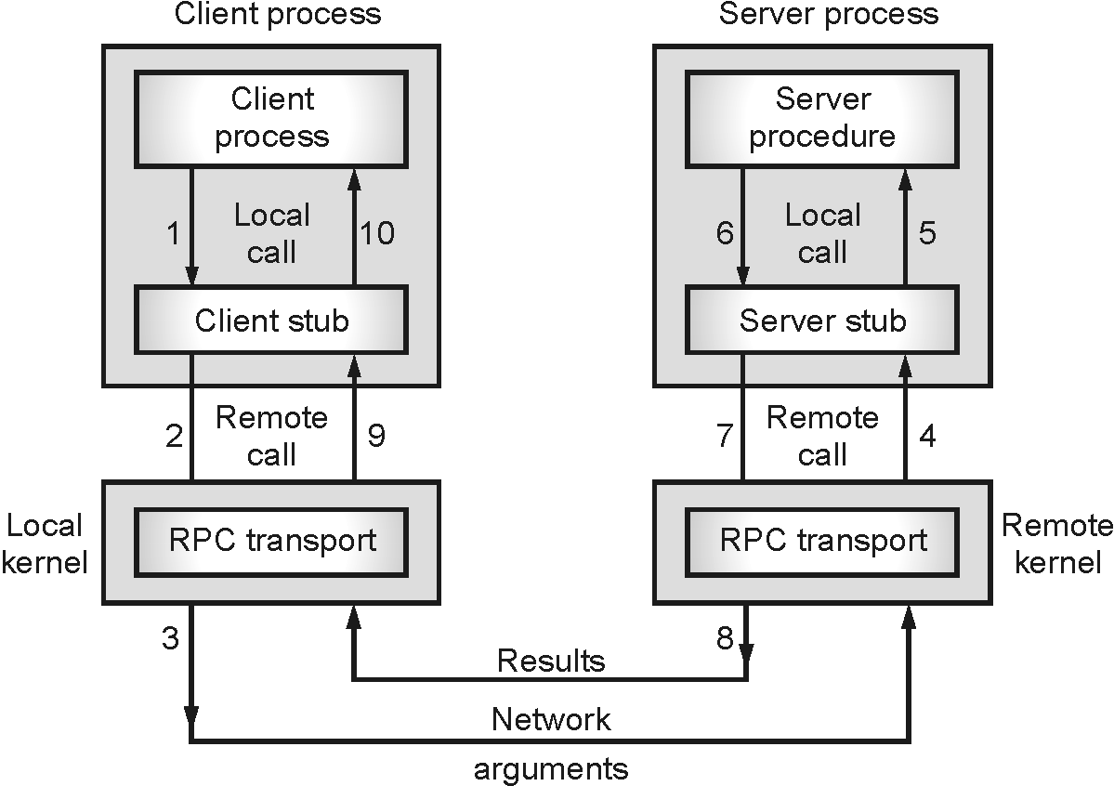
Working of RPC
Fig. 2.3.5 : Working of RPC

Slide 20
Issues of Remote Procedure Call (RPC)
(1) RPC Runtime
(2) Stub
(3) Binding
(4) The calling semantics associated with RPC

Slide 21
Advantages of RPC
Some of the advantages of RPC are as follows :
(1) Remote procedure calls support process-oriented and thread- oriented models.
(2) The internal message-passing mechanism of RPC is hidden from the user.
(3) The effort to re-write and re-develop the code is minimum in remote procedure calls.
(4) Remote procedure calls can be used in a distributed environment as well as the local environment.
(5) Many of the protocol layers are omitted by RPC to improve performance.

Slide 22
Disadvantages of RPC
Some of the disadvantages of RPC are as follows :
(1) The remote procedure call is a concept that can be implemented in different ways. It is not a standard.
(2) There is no flexibility in RPC for hardware architecture. It is only interaction based.
(3) There is an increase in costs because of the remote procedure call.

Slide 23
Parameter Passing in RPC
In RPC, parameters are passed in two ways, namely, call by value and call by reference.
In call by value, actual parameters are their data types are copied into a stack and passed to the called procedure.
In call by reference, a pointer to data is passed instead of value to the called procedure at the server end. However, it is very difficult to implement as the server needs to keep track of the pointer to the data at the client’s address space.

Slide 24
RPC Call Semantics
(1) Possibly or May-Be Call Semantics :
(2) Last-one Call Semantics :
(3) Last-of-Many Call Semantics :
(4) At-least-once Call Semantics :
(5) Exactly-once Call Semantics :

Slide 25
Communication Protocols for RPC
(1) Request Protocol
(2) Request/Reply Protocol
(3) The Request/Reply/Acknowledgement-Reply Protocol

Slide 26
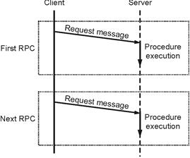
Fig. 2.3.6 : The request (R) Protocol

Slide 27
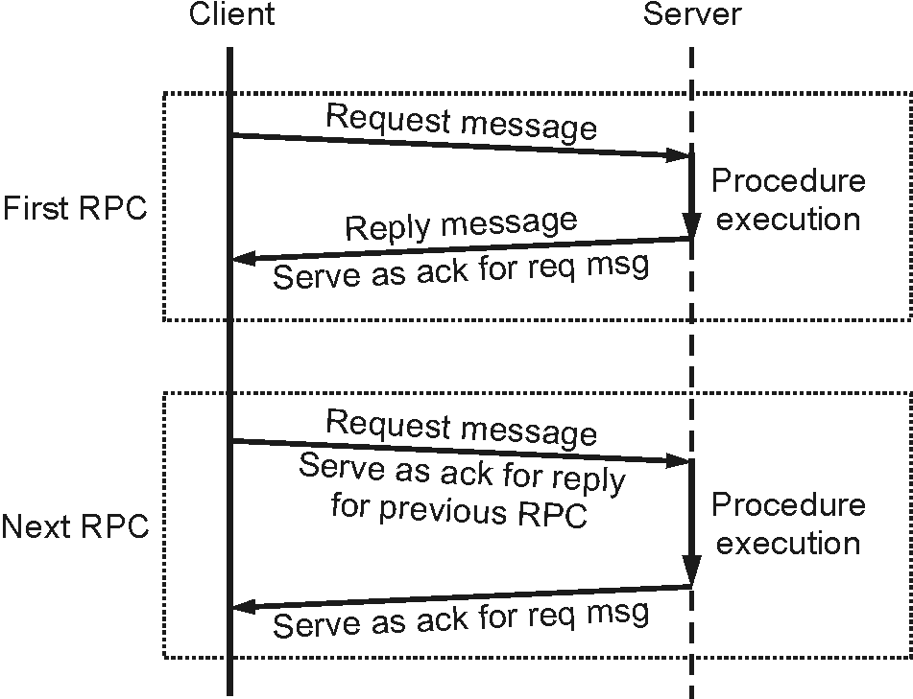
Fig. 2.3.7 : The request/reply (RR) Protocol

Slide 28
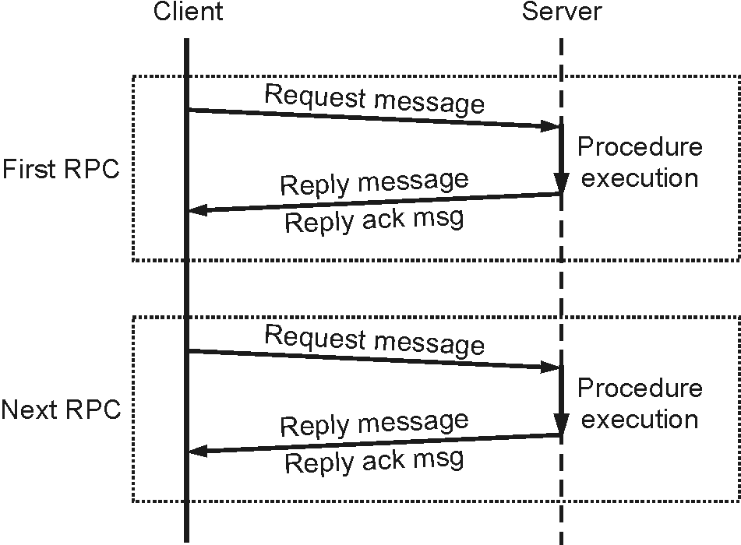
Fig. 2.3.8 : The request/reply/acknowledge-reply (RRA) Protocol

Slide 29
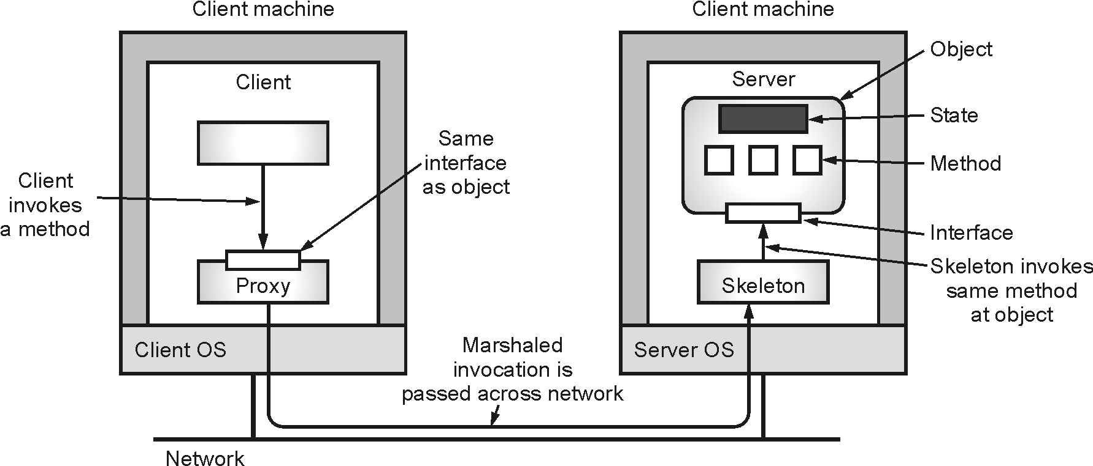
Remote Object Invocation
1. Distributed Object Model
Fig. 2.4.1 : Distributed Object

Slide 30
Remote Object Invocation
2. Compile-Time versus Runtime Objects
3. Persistent and Transient Objects

Slide 31
Remote Method Invocation (RMI)
Stub
Skeleton
RMI Architecture

Slide 32
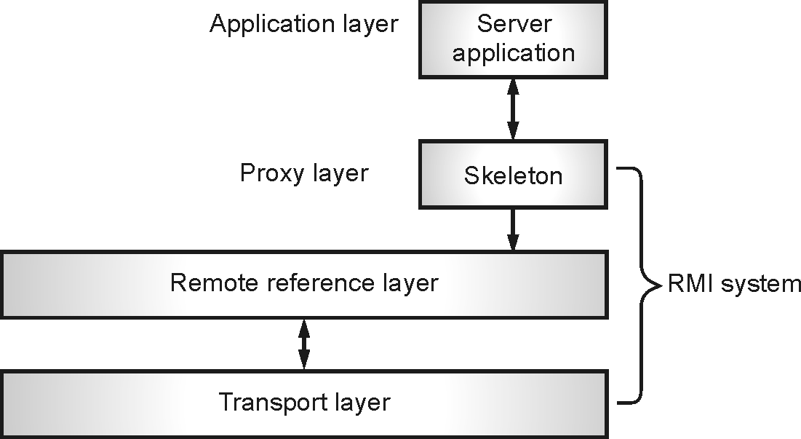
Fig. 2.5.2 : RMI Architecture
• The Java RMI architecture consists of three layers:
Proxy Layer (or Stub/Skeleton layer)
Remote Reference Layer (RRL)
Transport Layer.

Slide 33
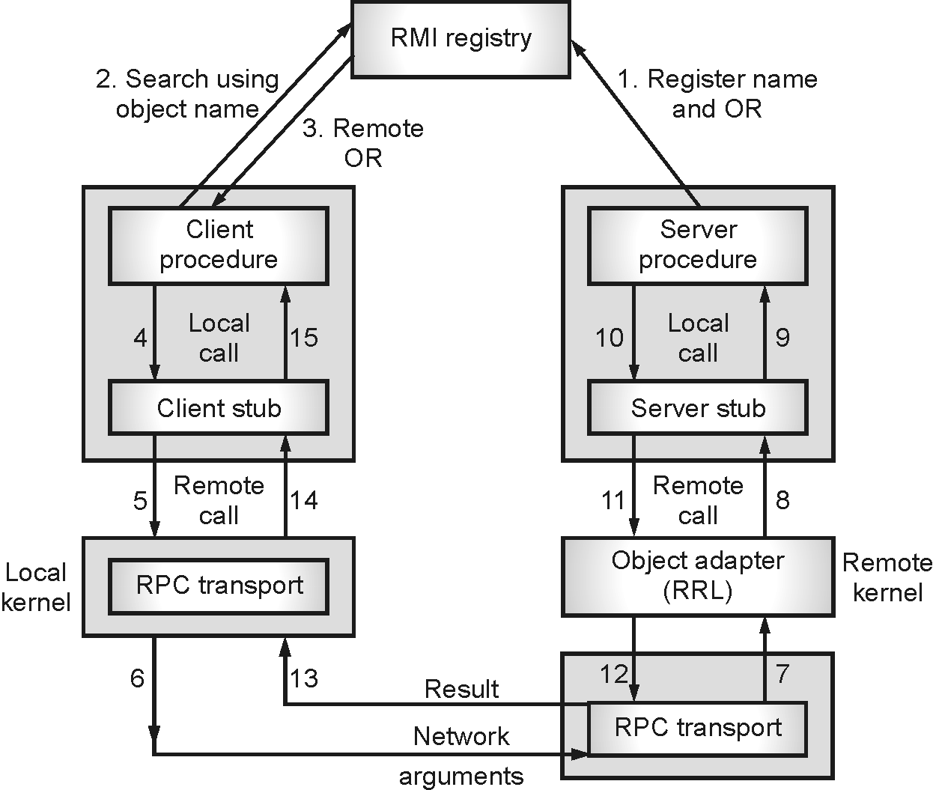
RMI Process
Fig. 2.5.3 : Remote Method Invocation Process

Slide 34
Advantages of RMI
(1) Simple and clean to implement that leads to more robust, maintainable and flexible applications.
(2) Distributed systems creations are allowed while decoupling the client and server objects simultaneously.
(3) It is possible to create zero-install client for the users.
(4) No client installation is needed except java capable browsers.
(5) At the time of changing the database, only the server objects are to be recompiled but not the server interface and the client remain the same.

Slide 35
Disadvantages of RMI
(1) Less efficient than Socket objects.
(2) Assuming the default threading will allow ignoring the coding, being the servers are thread- safe and robust.
(3) Cannot use the code out of the scope of java.
(4) Security issues need to be monitored more closely.

Slide 36
Message Oriented Communication
Persistence :
Synchronicity :
Persistent synchronous communication :
Transient asynchronous communication :
Receipt-based transient synchronous communication :
Delivery-based transient synchronous communication :
Response-based transient synchronous communication :

Slide 37
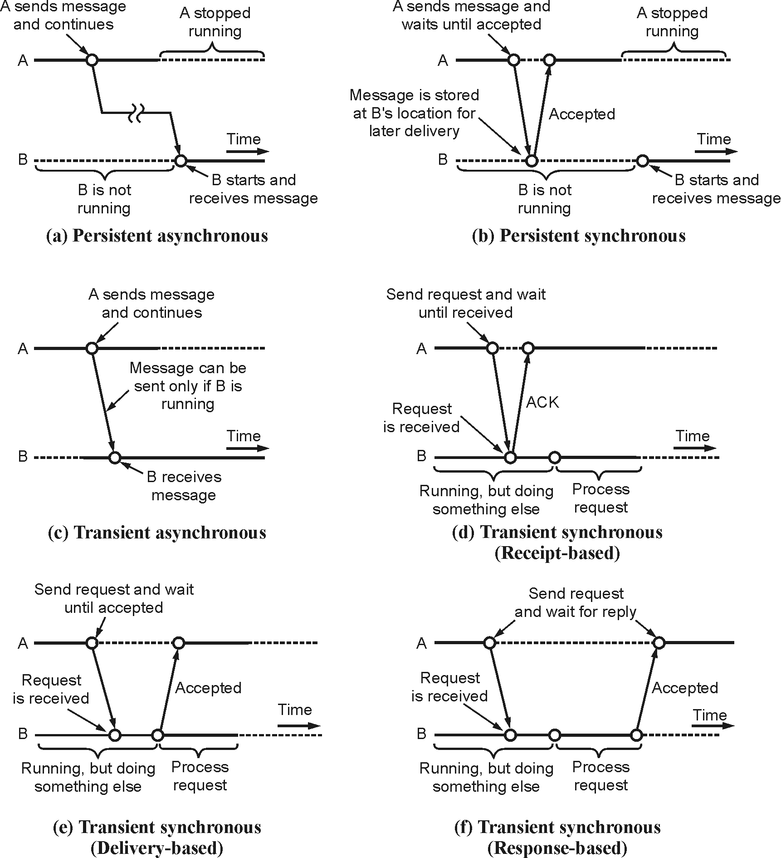
Fig. 2.6.1 : Types of Message Oriented Communications

Slide 38
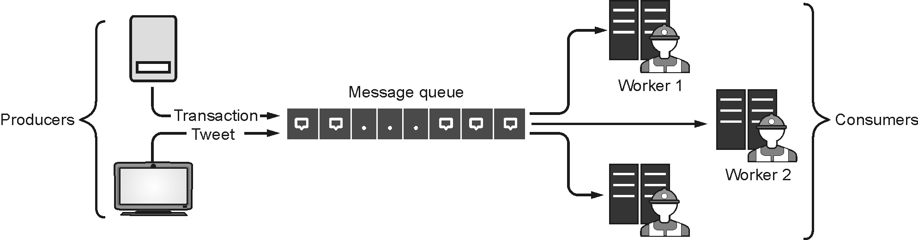
Message Queue
Fig. 2.6.2 : Message Queue
The message queue is comprised of two terms as shown in Fig. 2.6.2 :
• Message : this is the object passed from the producer to the Consumer. The object can be requests, information, meta-data, etc.
• Queue : this is a temporary buffer that stores messages. It uses the First-In-First-Out method to pass the messages from producer to Consumer.

Slide 39
Advantages of Message Queue
Better Performance :
Increased Reliability :
Granular Scalability
Simplifed Decoupling :
Break Up Apps :
Migrate to Microservices :
Shift to Serverless :

Slide 40
Stream-Oriented Communication
Transmission of time-dependent information can be done in three different modes.
In asynchronous transmission mode, data items of a stream are transmitted in sequence without further constraints, e.g., a file representing a still image.
Insynchronous transmission mode, data items of a stream are transmitted in sequence with a maximum end-to-end delay, e.g., data generation by a pro-active sensor
In isochronous transmissionmode, data items of a stream are transmitted in sequence with both a maximum and a minimum end-to-end delay, e.g., audio & video.

Slide 41
Quality of Service (QoS) in Stream Oriented Communication
The requirements include :
(1) Bandwidth :
(2) Maximum end-to-end delay bound :
(3) Jitter :
(4) Loss :

Slide 42
Comparison of Message-Oriented and Stream-Oriented Communication
Message-oriented communication | Stream-oriented communication
UDP (user datagram protocol) uses message-oriented communication | TCP (transmission control protocol) uses stream-oriented communication
Data is sent by application in discrete packages called messages. | Data is sent with no structure.
Communication is connectionless, data is sent without any setup. | Communication is connection oriented, connection established before communication.
It is unreliable, data delivery without acknowledgement. | It is reliable, data acknowledged.
Retransmission is not performed. | Lost data is reframed automatically.
Low overhead. | High overhead.
No flow control. | Flow control using sent protocol like sliding window.
Transmission speed is very high as compared to stream oriented. | Transmission speed is lower as compared to message oriented.
Suitable for applications like e-mail system where data must be persistent through delivered late. | Suitable for applications like audio, video where speed is critical than loss of messages.

Slide 43
Group Communication
• When one source process tries to communicate with multiple processes at once, it is called Group Communication.
• A group is a collection of interconnected processes with abstraction. This abstraction is to hide the message passing so that the communication looks like a normal procedure call.
• Group communication also helps the processes from different hosts to work together and perform operations in a synchronized manner, therefore increasing the overall performance of the system.

Slide 44
Types of Group Communication in a Distributed System
(1) Broadcast Communication :
(2) Multicast Communication
(3) Unicast Communication :

Slide 45
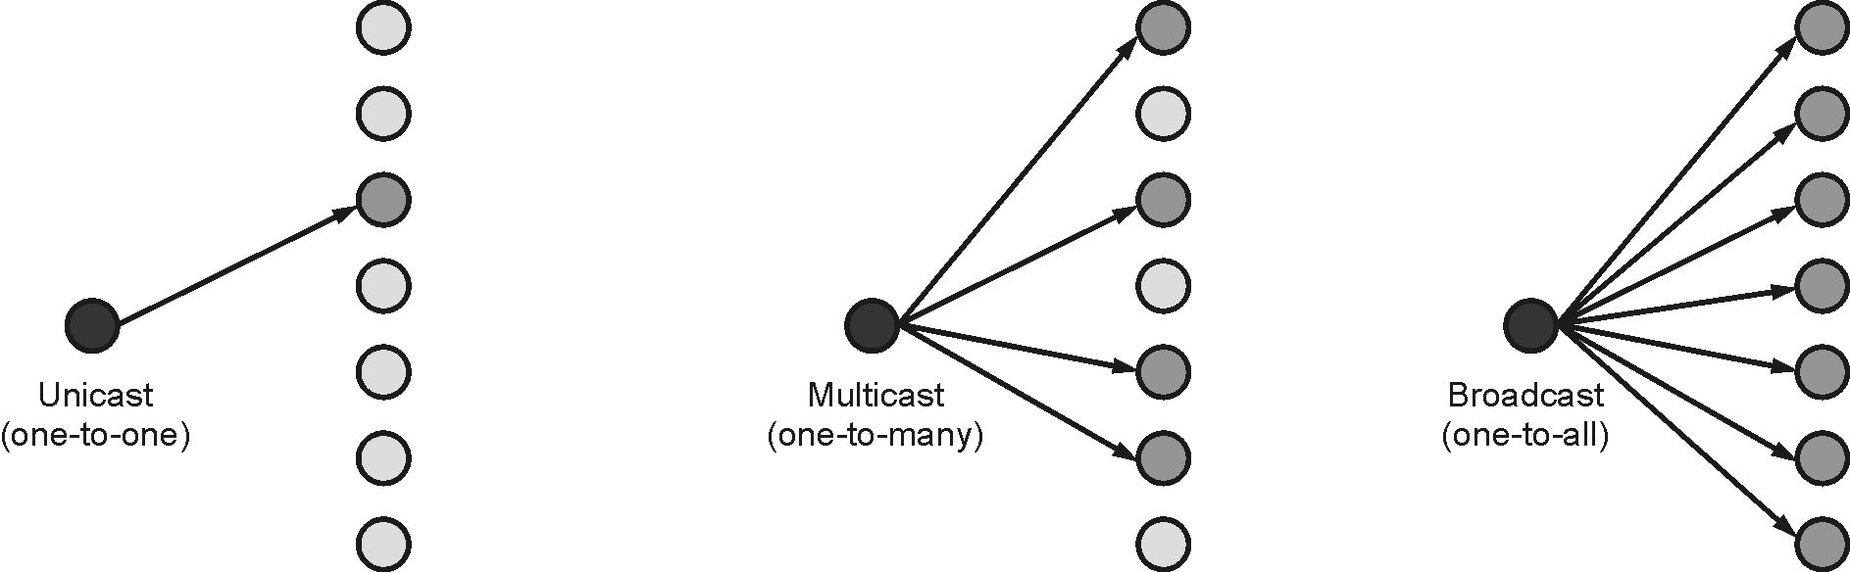
Fig. 2.8.1 : Types of Group Communication

Slide 46
Design issues in Group Communication
(1) Closed group vs. open group
(2) Peer groups vs. hierarchical groups
(3) Centralized group membership vs. distributed membership

Slide 47
Thank you!!!
Ashok.patade@djsce.ac.in

